Slide 1

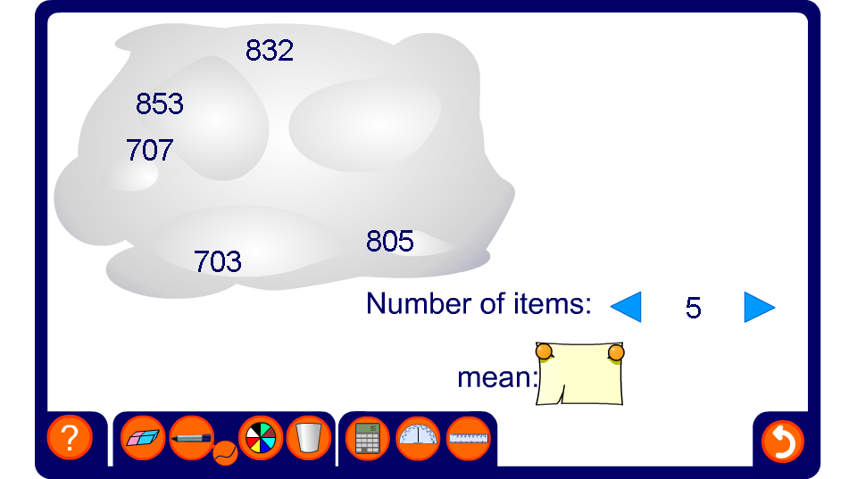


Calculating the mean
Notes:
Pupils could make their own clouds too. Working from the mean and the number of items, they should generate their own list of numbers to fit.

